Slide 1
Empowering Communities: Revolutionizing Citizen Engagement through the Smart City App

Slide 2

Welcome to Smart City App
Discover the power of through our Smart City App. Join us in revolutionizing citizen participation and building stronger, more connected communities.

Slide 3

Understanding Citizen Engagement
Empower citizens to actively participate in decision-making processes. Foster a sense of belonging and community pride by providing a platform for open communication and collaboration.

Slide 4

The Role of Technology
Leverage innovative technology to bridge the gap between citizens and local government. Utilize data-driven insights to inform policy decisions and improve urban living.

Slide 5
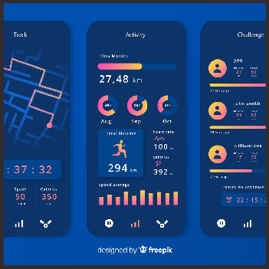
Features of Smart City App
Explore the various features of our Smart City App, including real-time alerts, community forums, event calendars, and interactive polls. Engage, connect, and collaborate like never before.

Slide 6

Empowering Local Businesses
Support and promote local businesses by providing a platform for targeted promotions, business directories, and community-driven initiatives. Strengthen the economic fabric of the city.

Slide 7

Enhancing Public Safety
Empower citizens to report safety concerns, access emergency services, and receive critical safety alerts. Foster a secure and resilient community through proactive engagement.

Slide 8

Data-Driven Decision Making
Leverage data analytics to gain insights into citizen preferences, behavior patterns, and community needs. Make informed decisions to enhance livability and urban development.

Slide 9
Encourage civic engagement through volunteer opportunities, community projects, and participatory budgeting. Empower citizens to play an active role in shaping the future of their city.

Slide 10

Building a Sustainable Future
Promote environmental sustainability through initiatives such as recycling programs, clean energy promotion, and community gardens. Create a greener, healthier, and more sustainable city.

Slide 11
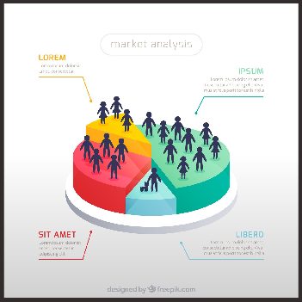
Measuring Impact and Success
Utilize key performance indicators and citizen feedback to measure the impact of the Smart City App. Celebrate successes and continuously improve the platform based on user input.

Slide 12

Fostering Inclusive Communities
Ensure that the Smart City App is accessible and inclusive for all members of the community, regardless of age, background, or ability. Embrace diversity and foster a sense of belonging for all.

Slide 13

Collaborating with Local Government
Forge strong partnerships with local government agencies to co-create solutions and address community needs. Foster a culture of collaboration and transparency for effective governance.

Slide 14

Championing Digital Inclusion
Bridge the digital divide by providing access to technology and digital literacy programs for all members of the community. Empower everyone to participate in the digital transformation.

Slide 15

Celebrating Community Achievements
Highlight success stories and community achievements facilitated through the Smart City App. Showcase the positive impact of citizen engagement and celebrate the spirit of community.

Slide 16

Embracing Smart City Innovations
Embrace the latest smart city innovations and technologies to create a connected, sustainable, and resilient urban environment. Empower citizens to be active participants in the city's transformation.

Slide 17

Looking Towards the Future
Explore the endless possibilities for further enhancing citizen engagement and community empowerment. Together, we can shape a future where every voice is heard and every community thrives.

Slide 18
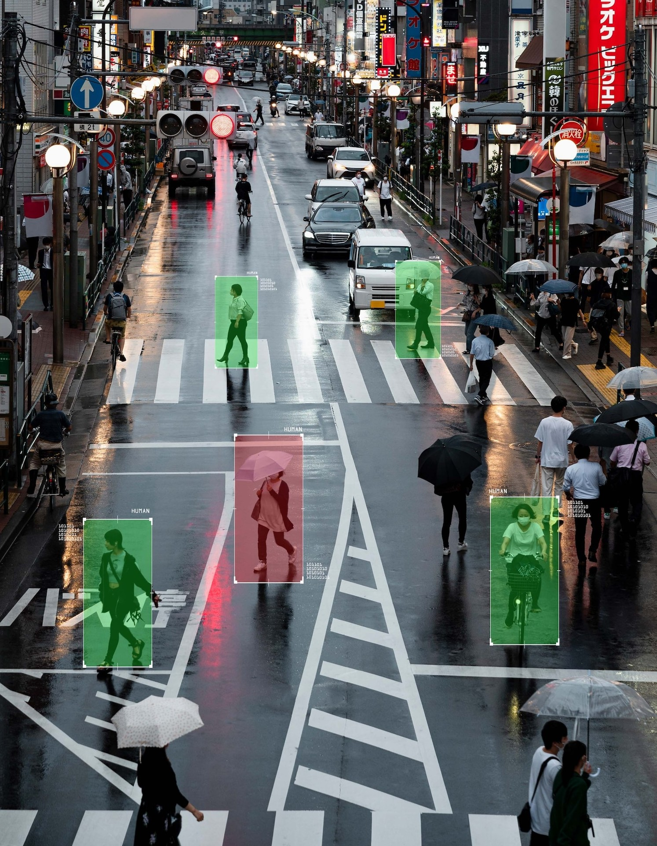
Join the Smart City Movement
Become a part of the Smart City App community and contribute to the transformation of urban living. Together, we can build stronger, more connected, and empowered communities.

Slide 19

Empowering Communities Together
Thank you for joining us in revolutionizing citizen engagement and building a brighter future for our communities. Let's continue to empower, connect, and inspire through the Smart City App.

Slide 20
Upcoming Features
Forecasting
Localized Language Support
Virtual Reality (VR) Tours
Augmented Reality (AR) Features

Slide 21

Thanks!
Do you have any questions? arunold600@email.com
+91 9629931469

